Slide 1
Loss Functions &
Gradient Descent

Slide 2
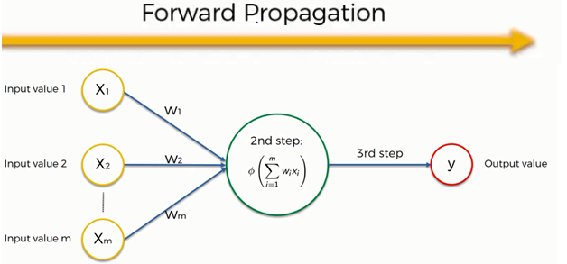
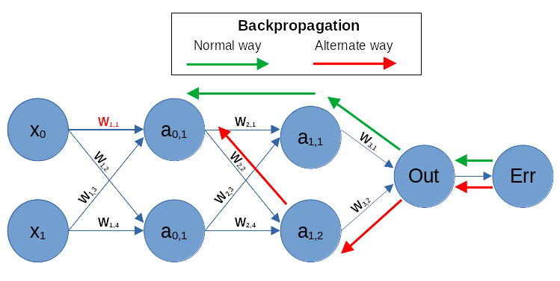
Working of Neural Networks
Forward Propagation
input
calculation -->then apply activation func
output
Backpropagation
Loss Calculation
Gradient Calculation
Weight Update
https://www.guru99.com/backpropogation-neural-network.html
Feedforward vs. Backpropagation
https://www.geeksforgeeks.org/backpropagation-in-neural-network/

Slide 3
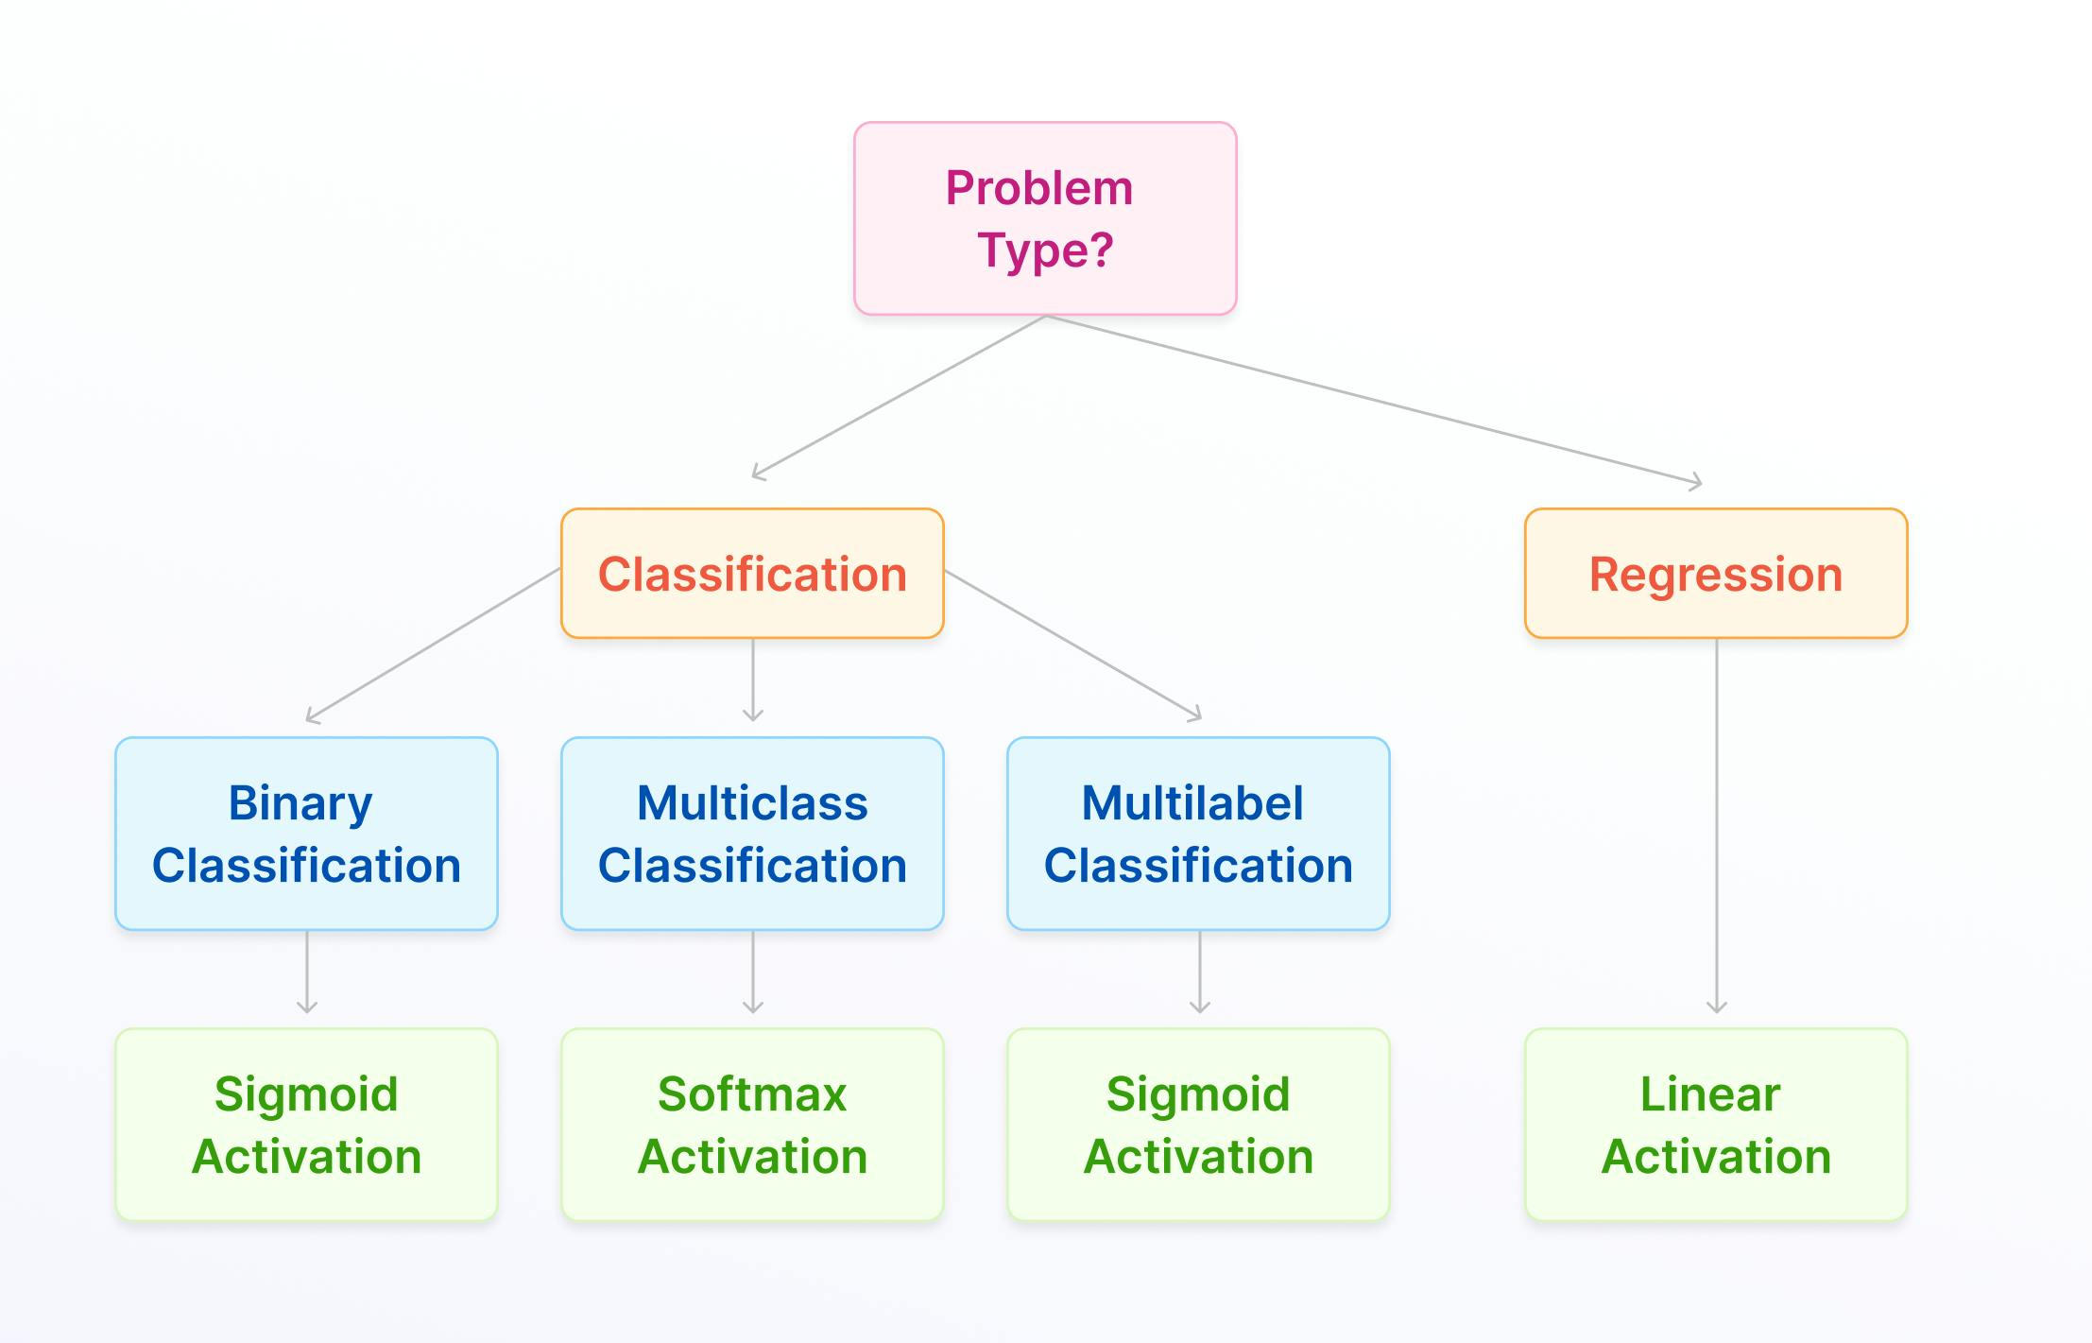
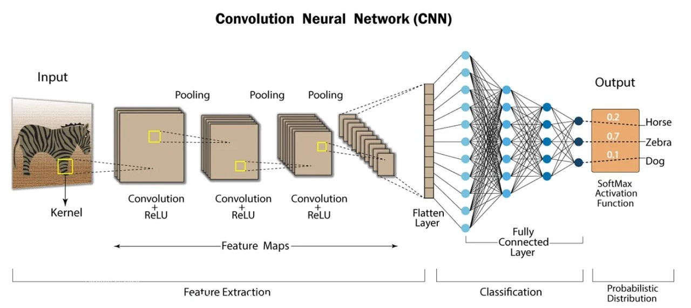

Slide 4
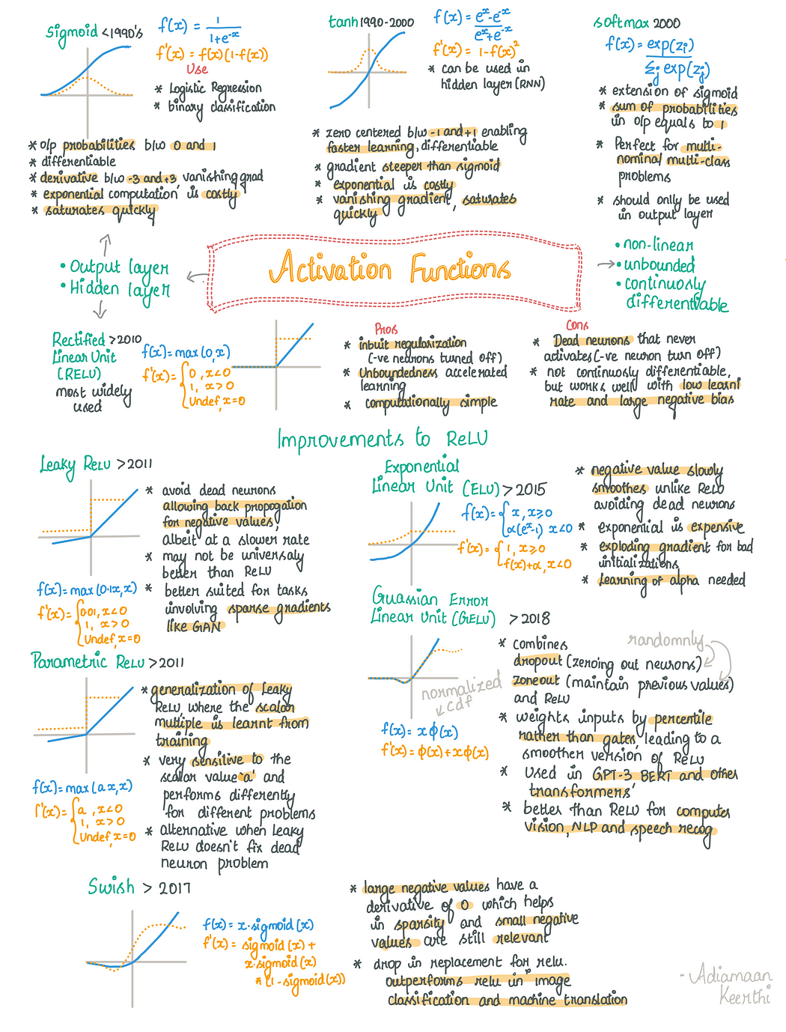

Slide 6
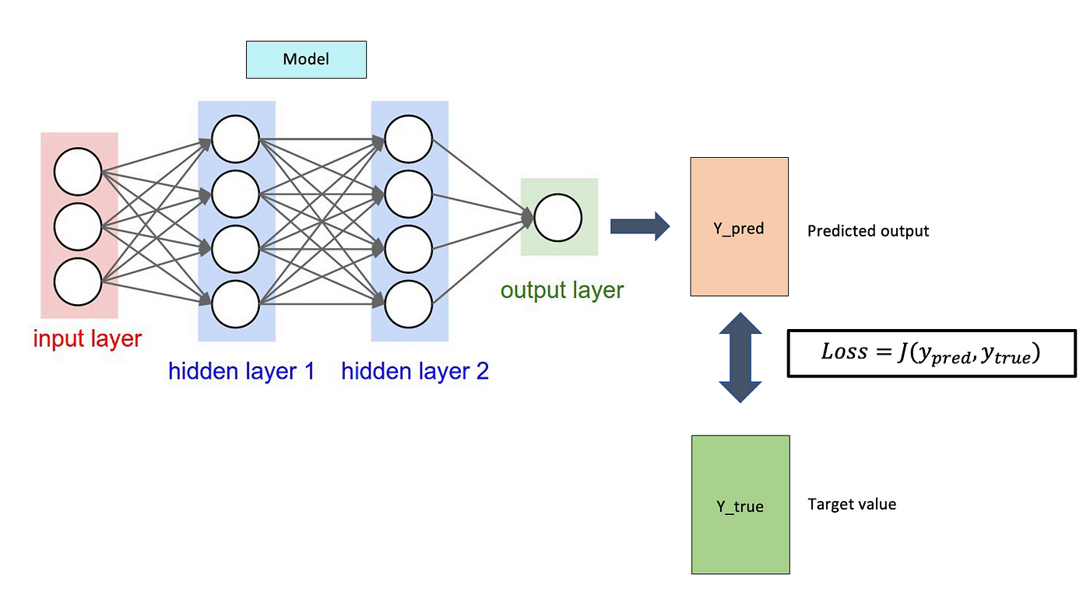
Loss function

Slide 7
loss function
A loss function in machine learning is a mathematical function that measures how well a model's predictions match the actual results. It's also known as an error function.
A loss function quantifies how well or poorly a model is performing by computing the error between the predicted and actual values.
Goal: Minimize this loss to improve model accuracy.
Used in both traditional ML and neural networks (NNs).
Why is a loss function important?
It helps determine how well an algorithm models a dataset
It helps guide the learning process and improve a model's predictions
It helps optimize a model's parameters, such as weights and biases
Guide Model Training:
Measure Performance:
Influence Learning Dynamics:
How does a loss function work?
A loss function takes the predicted output and the actual output as input and generates a scalar value that quantifies the difference between the two outputs.
https://www.geeksforgeeks.org/loss-functions-in-deep-learning/

Slide 8
2. Types of Loss Functions
In classical ML models (e.g., Linear Regression, Logistic Regression, SVM, Decision Trees), the loss function is typically:
✅ For Regression:
Mean Squared Error (MSE):
Mean Absolute Error (MAE)
Huber Loss (Robust to outliers)
✅ For Classification:
Log Loss (Binary Cross-Entropy) → Used in Logistic Regression
Hinge Loss → Used in SVMs
3. Loss Functions in Neural Networks (Deep Learning)
Neural networks also use loss functions but in a more complex setup because of multiple layers and non-linear activations.
✅ For Regression (NNs):
Mean Squared Error (MSE)
Mean Absolute Error (MAE)
✅ For Classification (NNs):
Binary Cross-Entropy (for binary classification)
Categorical Cross-Entropy (for multi-class classification)
Sparse Categorical Cross-Entropy (for one-hot encoded multi-class labels)
🔹 Key Difference: In deep learning, loss functions work with backpropagation & gradient descent, which is not always the case in traditional ML.

Slide 9
4. Are They the Same or Different?
Feature | Traditional ML Loss Function | Neural Network Loss Function
Purpose | Measures prediction error | Measures error but used in backpropagation
Usage | Used in simple models (e.g., Linear Regression, SVM) | Used in deep learning models (e.g., CNN, RNN)
Computation | Directly optimized | Combined with gradients & activation functions
Examples | MSE, Log Loss, Hinge Loss | MSE, Cross-Entropy, Huber, KL Divergence
✅ Conclusion: They are conceptually the same (both measure error), but NN loss functions are often more complex and integrated with gradient-based optimization.

Slide 10
Gradient Descent
Revisiting Gradient Descent, Momentum Optimizer, RMSProp, Adam

Slide 11
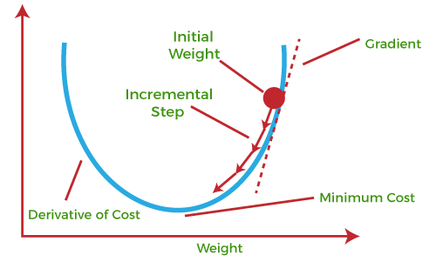
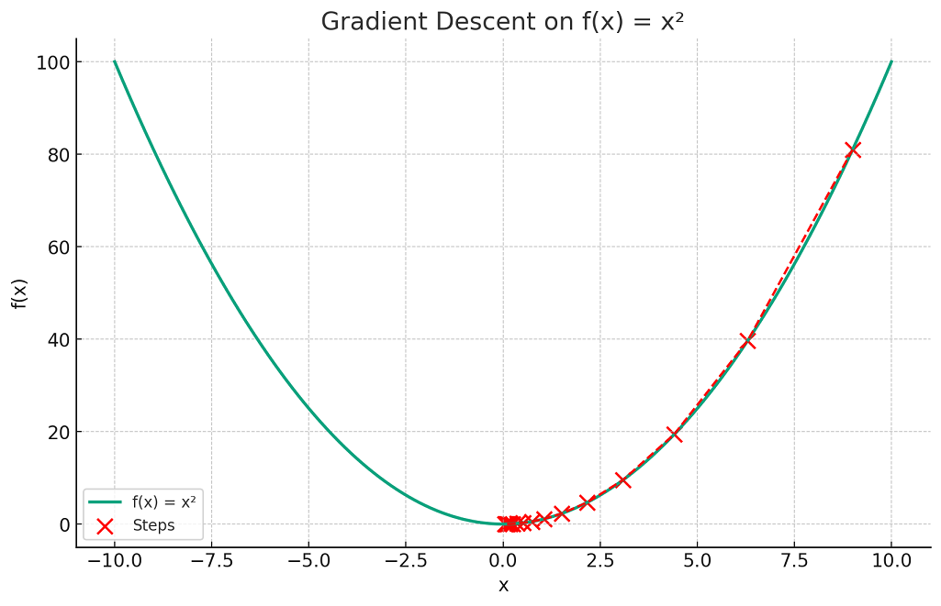
Gradient Descent
The gradient descent algorithm is an optimization algorithm used to minimize an objective function, commonly called the cost or loss function in machine learning. This cost function is a mathematical function used to calculate loss or error which is the difference between the model’s predicted value and the actual value in the real world for a given input data set.
term “gradient descent” is derived from two key concepts: “gradient” and “descent.”
Gradient: In mathematics and physics, the gradient of a function at any point is a multi-dimensional vector that points in the direction of the steepest increase of that function.
Descent: The word “descent” refers to the method’s objective of moving downwards to find the minima of the function.
https://www.mathsisfun.com/gradient.html
https://vitalflux.com/gradient-descent-explained-simply-with-examples/
https://www.coursera.org/articles/what-is-gradient-descent

Slide 12
Gradient Descent in Machine Learning vs. Deep Learning: Same or Different?
✅ Short Answer:Conceptually the same (both optimize a loss function by updating parameters), but in deep learning, gradient descent works with backpropagation and complex architectures.
1. What is Gradient Descent?
Gradient Descent is an optimization algorithm used to minimize a loss function by iteratively updating model parameters (weights and biases).
Goal: Find the optimal parameters that minimize the error.
Used in both traditional ML and deep learning models.
2. Gradient Descent in Traditional Machine Learning
🔹 Used in models like Linear Regression, Logistic Regression, SVM, etc.
🔹 Involves fewer parameters (only a few weights).
🔹 Can use closed-form solutions (e.g., Normal Equation in Linear Regression) when feasible.
✅ Example: Gradient Descent in Linear Regression
w=w−η⋅∂∂wJ(w)w = w - \eta \cdot \frac{\partial}{\partial w} J(w)
where:
ww = model weights
η\eta = learning rate
J(w)J(w) = loss function

Slide 13
3. Gradient Descent in Deep Learning
🔹 Used in neural networks (CNNs, RNNs, Transformers, etc.).
🔹 Works with millions of parameters (weights, biases in multiple layers).
🔹 Uses Backpropagation to compute gradients efficiently.
🔹 Requires GPU acceleration for large models.
✅ Example: Gradient Descent in Neural Networks (with Backpropagation)
Compute forward pass (calculate activations).
Compute loss using a loss function.
Backpropagation: Calculate gradients of loss w.r.t. each weight using chain rule.
Update weights using: w(l)=w(l)−η⋅∂∂w(l)J(w)w^{(l)} = w^{(l)} - \eta \cdot \frac{\partial}{\partial w^{(l)}} J(w) (where ll is the layer index)
4. Are They the Same or Different?
Feature | Gradient Descent in ML | Gradient Descent in Deep Learning
Usage | Optimizes models like Linear/Logistic Regression, SVMs | Optimizes Neural Networks (CNNs, RNNs, Transformers)
Complexity | Few parameters (simple weight updates) | Millions of parameters (complex backpropagation)
Training Time | Fast, can use closed-form solutions | Slow without GPUs, requires batch updates
Backpropagation? | ❌ No backpropagation needed | ✅ Uses backpropagation for weight updates
Memory Usage | Low | High (due to multiple layers)
✅ Conclusion:Same fundamental concept, but deep learning gradient descent is more complex due to backpropagation and large parameter spaces.
Would you like a Python example comparing both? 🚀

Slide 14
GRADIENT CODE
importnumpy as np
importmatplotlib.pyplot as plt
# Defining a simple quadratic function and its derivative
f =lambdax: x**2
f_prime =lambdax: 2*x
# Generating values
x =np.linspace(-10, 10, 400)
y =f(x)
# Gradient descent settings
learning_rate =0.15
x_start =9 # Starting point
steps =[x_start]
n_iterations =15
# Gradient Descent Iteration
for_ in range(n_iterations):
x_start =x_start -learning_rate *f_prime(x_start)
steps.append(x_start)
# Plotting the function
plt.figure(figsize=(10, 6))
plt.plot(x, y, lw=2, label=&amp;quot;f(x) =x²&amp;quot;)
# Plotting the steps
plt.scatter(steps, f(np.array(steps)), color='red', s=100, label='Steps')
plt.plot(steps, f(np.array(steps)), color='red', linestyle='--', lw=1.5)
# Annotations and labels
plt.title('Gradient Descent on f(x) = x²')
plt.xlabel('x')
plt.ylabel('f(x)')
plt.legend()
plt.grid(True)
plt.show()

Slide 15
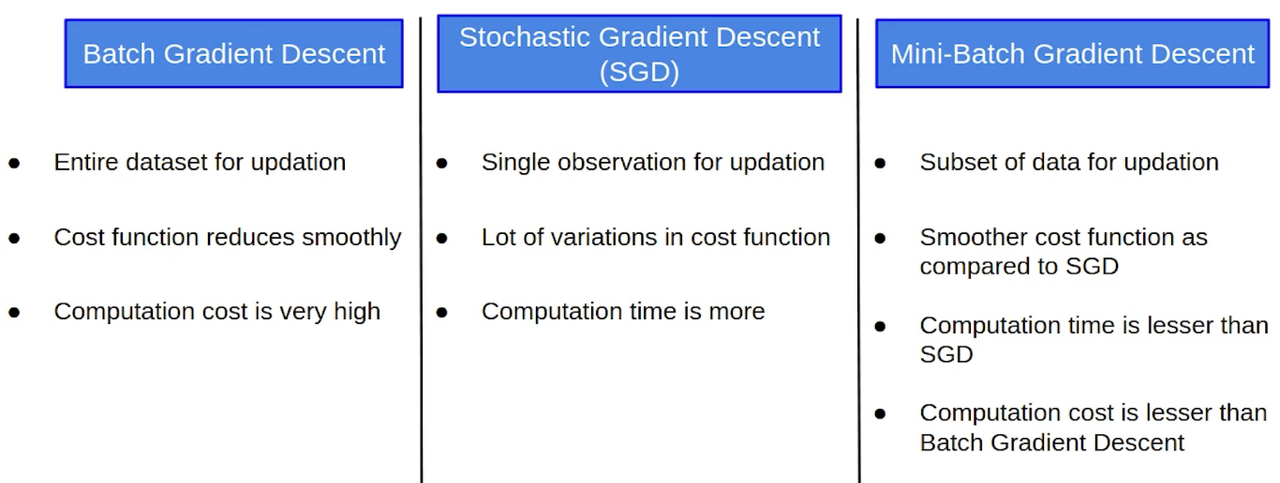
Computation time is more in sgd and Computation cost is very high in batch what it means
SGD: Fast per-iteration, but may take more iterations (more time overall) and can be noisy due to updates based on individual samples. Works well for very large datasets and can be parallelized or used in online settings.
Batch Gradient Descent: More stable per iteration but computationally expensive, especially with large datasets. Can converge faster in terms of number of epochs but may take a long time per epoch.

Slide 16
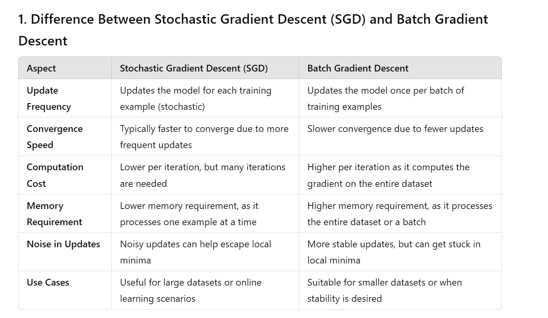

Slide 17
OPTIMIZERS IN DEEP LEARNING

Slide 18
Optimizers in Deep Learning
1. What is an Optimizer?
An optimizer is an algorithm that adjusts the weights and biases of a neural network to minimize the loss function and improve model performance.
✔ Goal: Update model parameters using gradients computed via backpropagation.
✔ Optimizers control learning speed, convergence stability, and generalization.
2. Types of Optimizers in Deep Learning
Optimizers are mainly categorized into two types:
Type | Description | Examples
First-order optimizers | Use first-order derivatives (gradients) | SGD, Momentum, RMSprop, Adam
Second-order optimizers | Use second-order derivatives (Hessian matrix) for curvature | Newton’s Method, L-BFGS (less common in deep learning)

Slide 19
Type | Description | Examples
First-order optimizers | Use first-order derivatives (gradients) | SGD, Momentum, RMSprop, Adam
Second-order optimizers | Use second-order derivatives (Hessian matrix) for curvature | Newton’s Method, L-BFGS (less common in deep learning)
3. Popular Optimizers in Deep Learning
🔹 (1) Stochastic Gradient Descent (SGD)
✔ Formula:
w=w−η⋅∂J∂ww = w - \eta \cdot \frac{\partial J}{\partial w}
✔ Pros: Simple, works well for small datasets.
✔ Cons: Can be slow, struggles with noisy gradients.
✅ Variant:Mini-batch SGD (faster, more stable).
🔹 (2) SGD with Momentum
✔ Adds a velocity term to accelerate updates in the right direction.
✔ Helps escape local minima and smoothens updates.vt=βvt−1+η∂J∂wv_t = \beta v_{t-1} + \eta \frac{\partial J}{\partial w}w=w−vtw = w - v_t
✔ Pros: Faster convergence, less oscillation.
✔ Cons: Still needs careful tuning of parameters.

Slide 20
🔹 (3) RMSprop (Root Mean Square Propagation)
✔ Idea: Uses a moving average of squared gradients to adjust learning rates adaptively.
✔ Solves the vanishing/exploding gradient problem.w=w−ηSt+ϵ∂J∂ww = w - \frac{\eta}{\sqrt{S_t} + \epsilon} \frac{\partial J}{\partial w}
✔ Pros: Works well for RNNs and deep networks.
✔ Cons: Requires tuning decay rate β.
🔹 (4) Adam (Adaptive Moment Estimation) [MOST POPULAR]
✔ Combines Momentum + RMSprop → adaptive learning rate + velocity smoothing.mt=β1mt−1+(1−β1)∂J∂wm_t = \beta_1 m_{t-1} + (1 - \beta_1) \frac{\partial J}{\partial w}vt=β2vt−1+(1−β2)(∂J∂w)2v_t = \beta_2 v_{t-1} + (1 - \beta_2) (\frac{\partial J}{\partial w})^2
✔ Pros: Fast convergence, works well for most problems.
✔ Cons: Can sometimes overfit or not generalize well.
🔹 (5) AdamW (Adam with Weight Decay) [BETTER THAN ADAM]
✔ Fixes Adam's tendency to overfit by decoupling weight decay from gradient updates.
✔ Used in Transformers (e.g., BERT, GPT models).
4. Which Optimizer Should You Use?
Scenario | Best Optimizer
General deep learning | Adam (fast, adaptive)
Large-scale NLP (Transformers) | AdamW (prevents overfitting)
Simple problems (Regression, MLPs) | SGD
Image classification (CNNs) | SGD + Momentum / Adam
Recurrent Neural Networks (RNNs, LSTMs) | RMSprop / Adam

Slide 21
5. Code Example (Comparing Optimizers in TensorFlow/Keras)
6. Key Takeaways
✅ SGD is simple but slow.
✅ Momentum helps accelerate training.
✅ RMSprop is useful for RNNs.
✅ Adam is the most commonly used optimizer.
✅ AdamW is the best choice for large models like Transformers.
Would you like a comparison plot of optimizers on a dataset? 🚀

